Slide 1
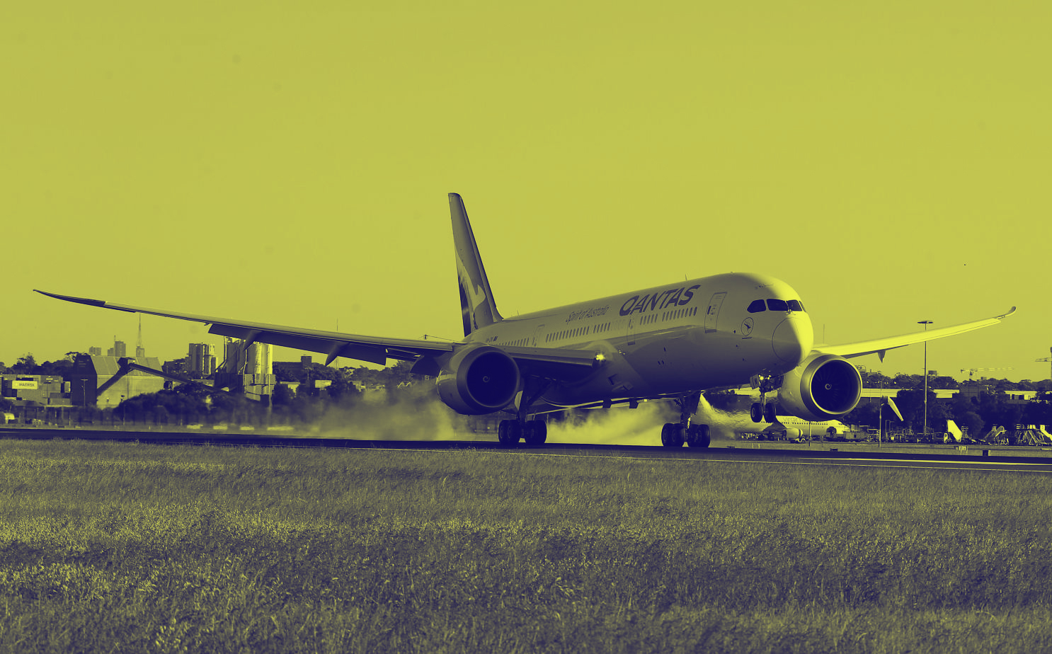
Daily Aircraft Trips Prediction
Australia Domestic Flight
During Covid-19
Using Machine Learning
Prepared by : Denny Setia Dwiputra

Slide 2
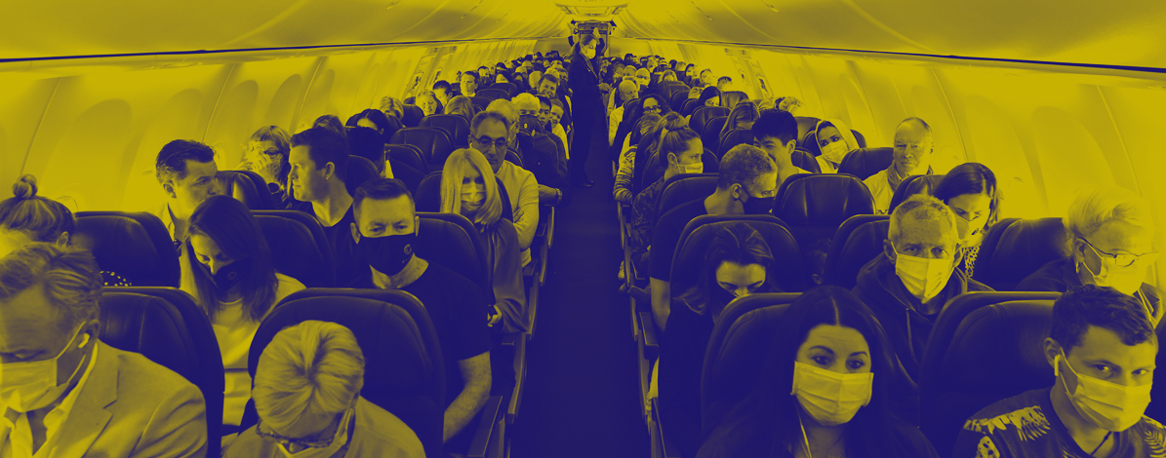
Background of The Project
Because of this anomaly year, The Airline Company couldn't use the historical data to predict their passengers to calculate their revenue, their fare, and how to calculate the ticket price from this obscurity. So they have to think more than before, but we still could predict by we take the flight traffic data as much as possible in this year.
But the problem is , We couldn't predict the traffic in future, we still in the anomaly year, many country make their own policy to keep their citizens safe, just like in Australia, several region make territorial quarentine to avoid the spread of the virus, so I think its useless to predict the demand of the passenger in the future and nearly the end of this year, We are still waiting for uncertainly about the safety and healty from this virus.

Slide 3
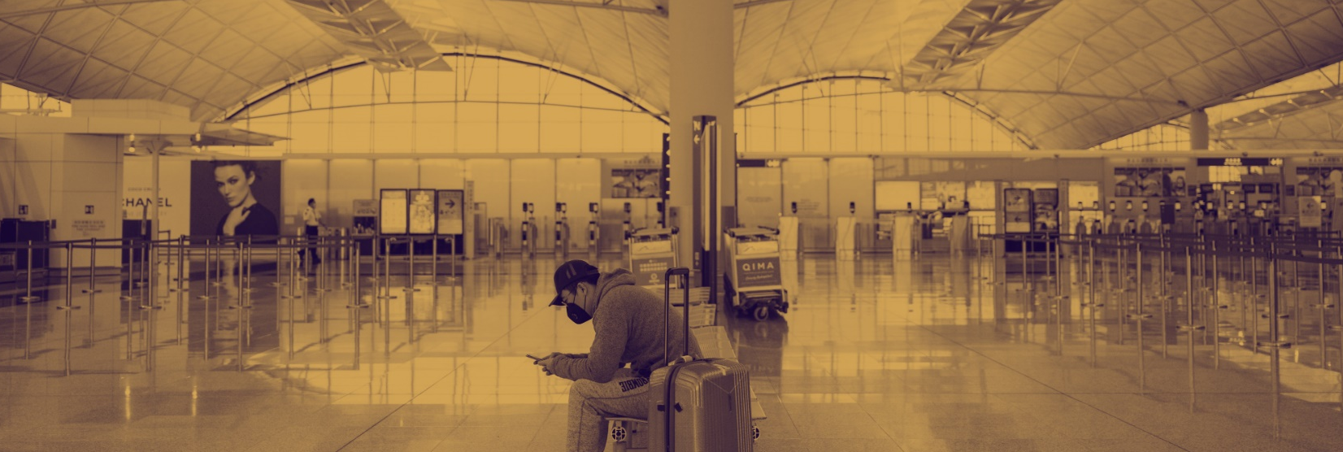
Airline Industry in 2020
The worst year of the airline Industry, Covid-19 gave massive impact to every Airline Industry, They have to survive with this condition untill we find the best solution and recover as soon as possible, especially we are trying to finding and waiting for testing of the vaccine from this virus.
Several Airlines Industry have to commit that they cant survive, ask for bankruptcy protection. They have to layoff their employees because of financial problem. Several Airlines cant continue their bussines, they declared bankruptcy.

Slide 4
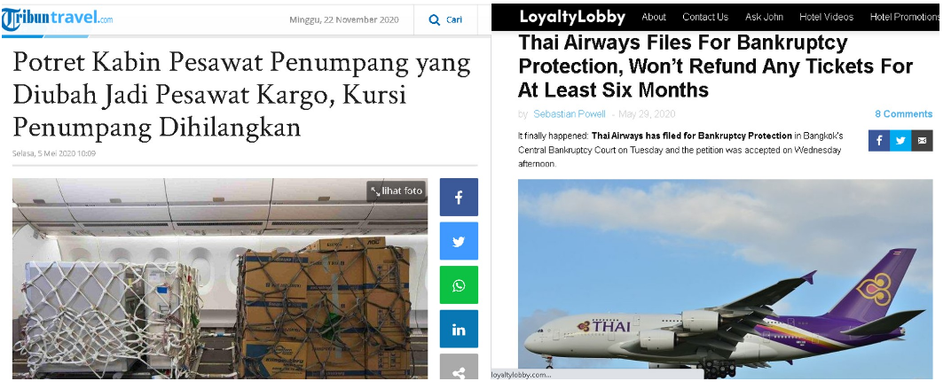
Airline Industry in 2020

Slide 5
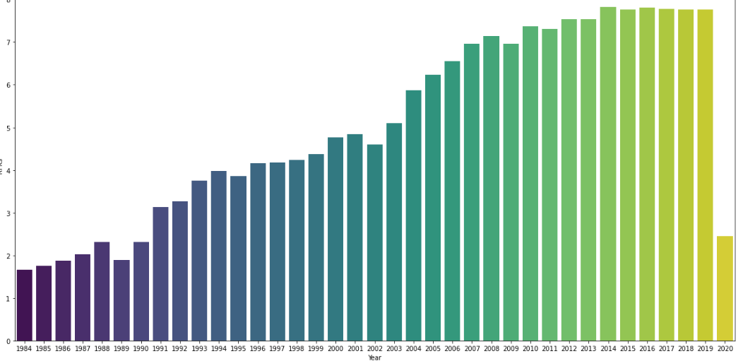
Passenger Trends from 1984-2020
We could see that Corona Virus Disease 19 (Covid-19) in 2020 Obviously create a massive impact for RPKs this year and had beaten the airline Indsutry all around the world.
Airline Bussines is dinamic bussines, they really depends on the passenger each day, Month, and Year. By the time ,the airline industry getting bigger and bigger, as we could see there, since 1984-2019, RPKs (Revenue Seats Kilometers) in Australia grows very quickly and becomes a promising and highly competitive bussiness.

Slide 6

Big Problem
Despite of this, the airline bussines was destroyed because of this pandemic, people should be stayed at home to stop the spread of the virus, many Country take an action to did a Lockdown, All the airport decided to close flight for the safety reason, in the end of third month 2020, this pandemic getting bigger and couldn't be prevented, , they have to change bussines concept and try to save thier money as much as possible
Several Airline decided to grounded their Aircraft and the other trying hard to survive in this hard situation by change their aircraft configuration from the Passenger aircraft to cargo aircraft, but it is not an easy way to change that ! They have to spend 2.5 to 3 million USD.

Slide 7

Goals
We would predict the possible aircraft trips as Efficient as Possible
In this project, We would like to predict on the next month, how many flight could be possible in a spesific route based on load factor the month before or the average load factor this year, with the limitation of available seat (On several Airline) because of the safety reason (Social Distancing) to reduce the spread of the virus and the most important think is to restore the customers trust to fly again over the region or maybe over the country.

Slide 8

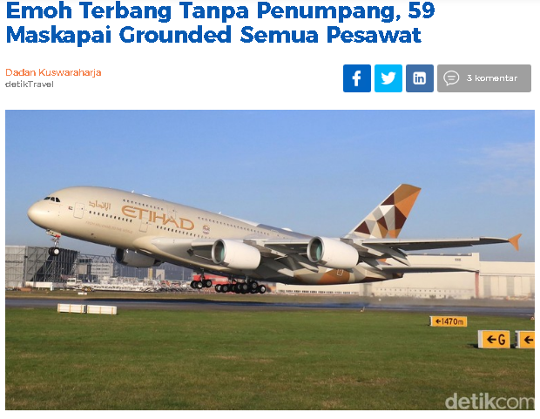
Why we should predict aircraft trips?
They lost a lot of money, if they fly with empty passengers.
In every flight , they have to spent a lot of money (Operational Cost)
so this year, they have to save their money as much as possible by predicting the aircraft trips in a route.

Slide 9

Aircraft Trips
The number of flight stages. A return flight counts as two aircraft trips. (frequency of flights in a month)
Load Factor
The total revenue passenger kilometres performed as a percentage of the total available seat kilometres.

